Slide 1

HiveTech
Innovations

Slide 2
Building a Better Bee

Slide 3
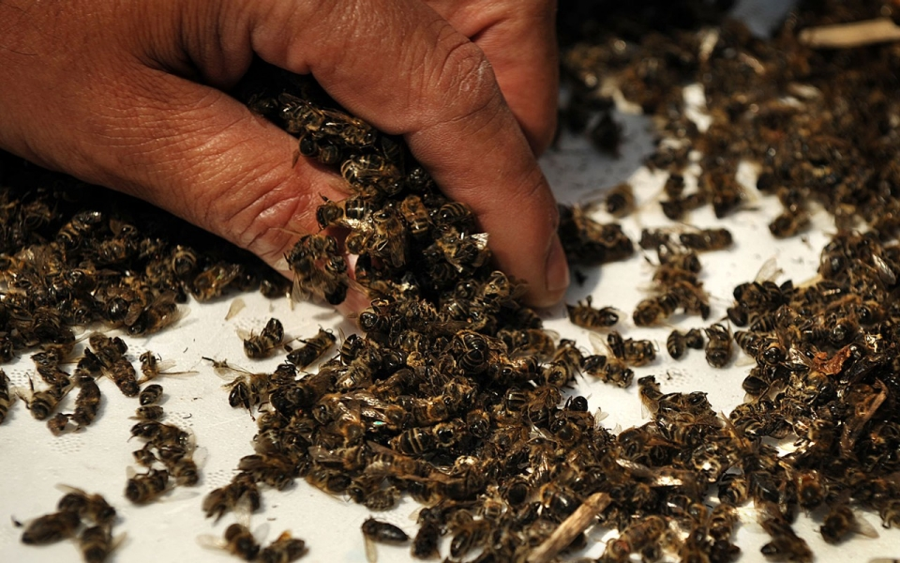
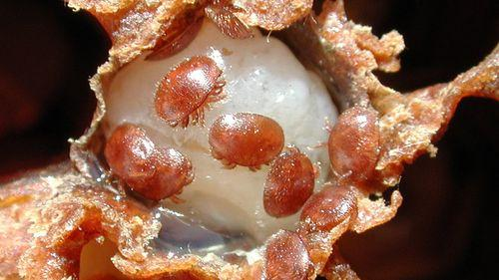
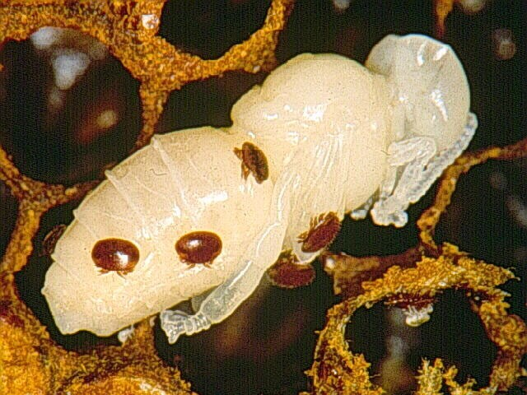
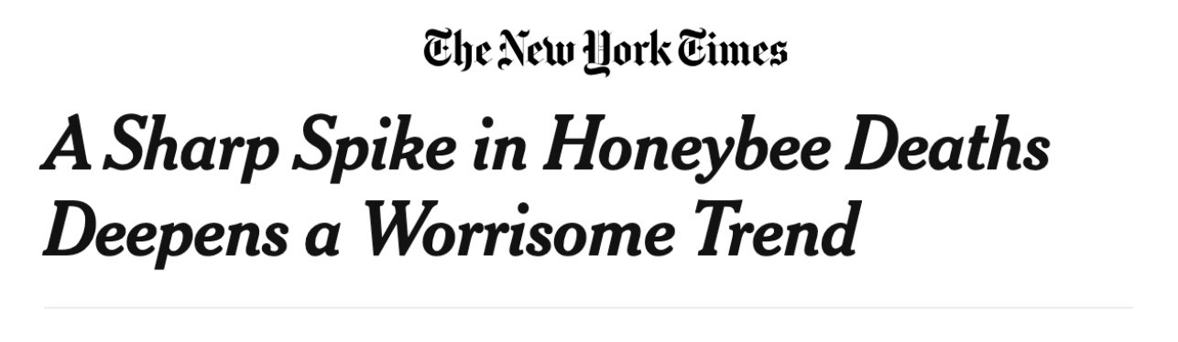
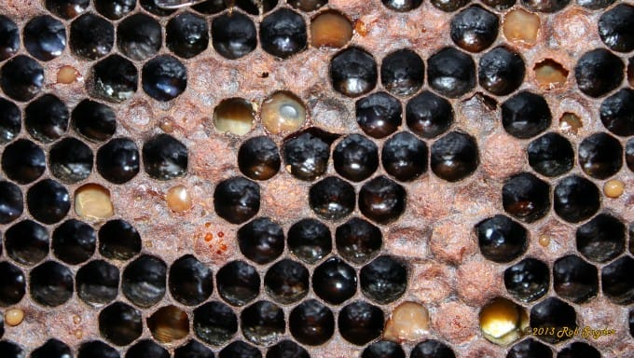
Notes:
https://www.nytimes.com/2015/05/14/us/honeybees-mysterious-die-off-appears-to-worsen.html

Slide 4
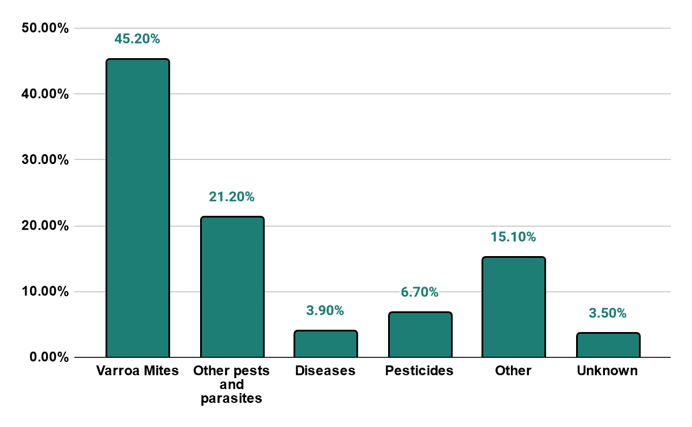
What is killing the bees?!

Slide 5



Meet the Team:
Wes Huneycutt
CEO
Sabrina Pinard
CTO
Catherine Cheedle
CFO
Notes:
HiveTech Innovations, is a hypothetical company dedicated to preserving and promoting the Honeybee, the world’s most popular pollinator. Without the support and dedication to the honeybee, several of our commodities would no longer be available and the Earth as we know it would be changed forever.

Slide 6
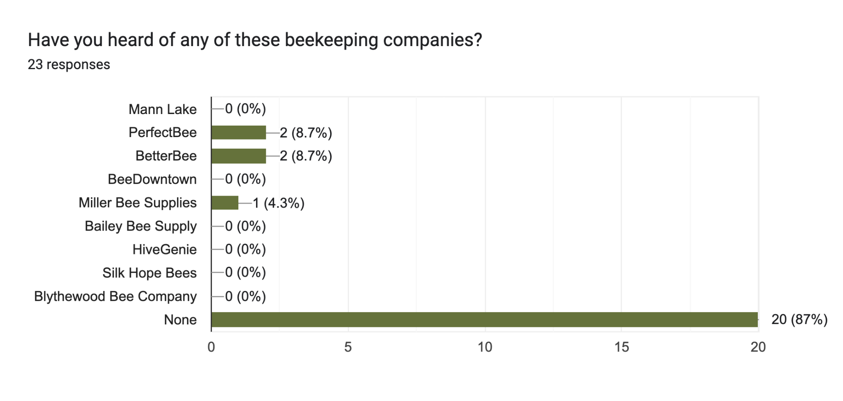
Market Presence

Slide 7
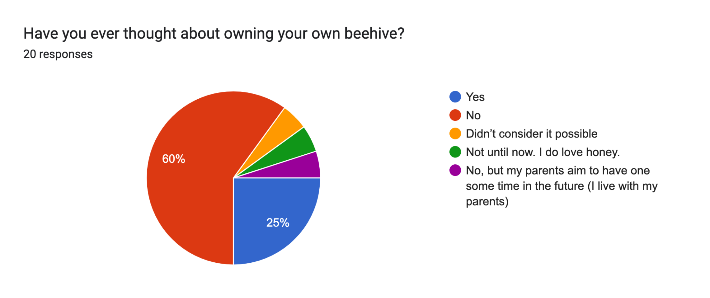
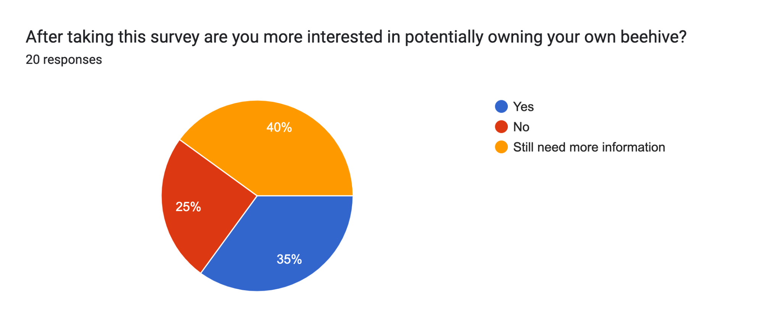
Notes:
Bigger and quick

Slide 8
Varroa Mite
Resistant
Cold Resistant
American Foulbrood Resistant
HiveTech Innovation’s
Honey Bees
Neonicotinoid
Pesticide Resistant
Heat Resistant
Tracheal Mite Resistant

Slide 9
Worldwide pollination reliant crops:
$235-$577 billion
US pollination reliant crops:
$20 billion
NC and SC reliant crops:
$194 million

Slide 10






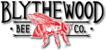







Service
Location
Hive Quality
Sustainability

Slide 11
Nuclear Colony | $190 | $162-215 | $225 | $210
Hive Frame | $309.95-365.75 | $195.95-269.95 | $199-223.95 | $220
Basic Starter Kit (not including bees) | $206-618 | $233.95-589.95 | $325 | $300
Protective Gear (jackets and gloves) | $114.95-164.95 $16.75-33.50 | $99.95-169.95 $24.95 | $85-165 $22.95-26.95 | $110 $20
Consultation | NA | NA | NA | 2 Free
Total | $837.65-1,372 | $716.8-1,269.8 | $856.95-965.9 | $860

Slide 12
Pricing Tiers
Hive set up and Queen Bee
Two free consultations with professional apiarists
Hive set up and Queen Bee
Monthly check ups with professional apiarists
Access to Beekeeping Resource Guide
Professional
Hive set up and Queen Bee
Biweekly professional apiarists check ups
Yearly Harvest Service
Access to Beekeeping Resource Guide
Access to emergency professional apiarist help
Essentials
Business
$999
One time payment
$999
One time payment
+ $129 monthly
$999
One time payment
+ $259 monthly
* Subscription service valid only in the Carolinas.
* Additional mileage costs for distances over 150 miles.
* Payment plans available.

Slide 13
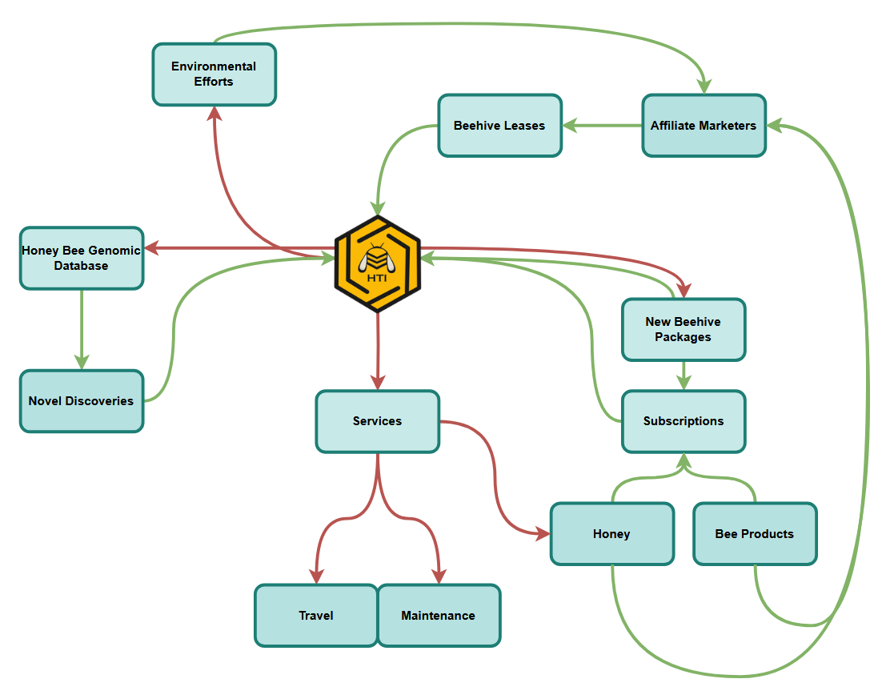
Notes:
Bigger, dollar signs

Slide 14
Strengths
Genomic Data
Data Informed Decisions
Hybrids
Business Integration
Weaknesses
GMO misunderstandings
Scale of Finance
Genetics of Bees
Opportunities
Save the Bee Initiatives
NC Local Beekeepers
Beehive Grant Programs
Threats
Novel Diseases
Government Regulations
Bee Growth Timescale
Notes:
White text add with animation

Slide 15
5 Year Timeline
Import Base Hives
+
Research and Development
Year 1
Build Nuclear Hives
First Official HTI Hive Sold
Year 3
Year 5
Implement Research
+
Build Stock Hives
Year 2
Conduct Impact (Environmental) Studies
+
Presale
Year 4

Slide 16
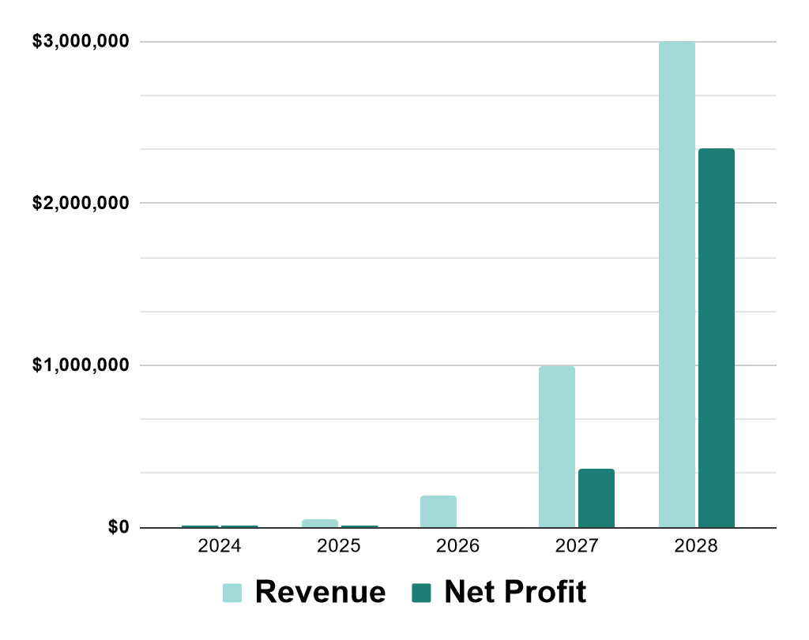
Monthly Expenses Year 1
Lab Space | $30,000
Labor | $12,700
Materials | $2,000
Other | $1,300
Total | $46,000
Yearly
 | 2024 | 2025 | 2026 | 2027 | 2028
Expense | $765,000 | $560,000 | $560,000 | $640,000 | $660,000
Revenue | $0 | $50,000 | $200,000 | $1,000,000 | $3,000,000
Net Profit | $0 | $0 | $0 | $360,000 | $2,340,000

Slide 17
Our Ask
$6,000,000
We are looking for funding to finish development of our bee, hire new staff, and become a staple of the beekeeping community.
Development - $4 million
Employees - $1.5 million
Materials - $500,000
Notes:
Secures:
A minimum of two years of labspace rent
Access to CRISPR technology for sequencing and research
Opportunities for further product development and quality assurance

Slide 18
Thank you for your time
Questions?

